Slide 1
Modeling the Action Potential: Comparison of Algorithms
David Goldfarb
Department of Electrical and Computer Engineering, University of Rochester
Notes:
Intro: I chose this topic because I’m interested in how information gets propagated through the body. I chose to model the action potential of a neuron because of its important role, but since it’s been done before I decided to do it two ways and compare them.

Slide 2
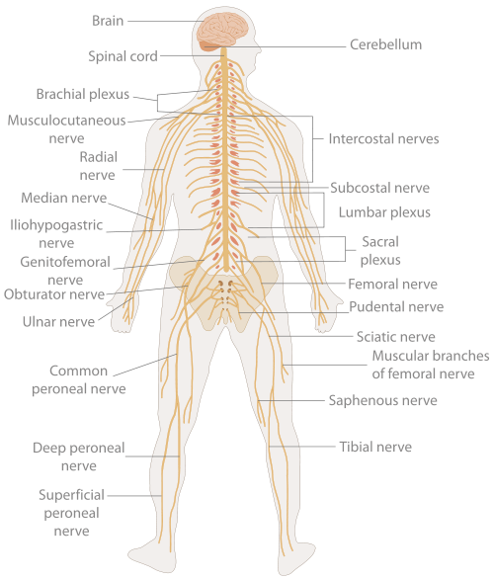
Background
Information is carried through the body by nerves.
They control movement, transmit sensory information, etc.
Propagated action potentials
Notes:
This isn’t a bio class, so don’t give too much background on the neuron. The image sets the background
http://en.wikipedia.org/wiki/File:TE-Nervous_system_diagram.svg

Slide 3
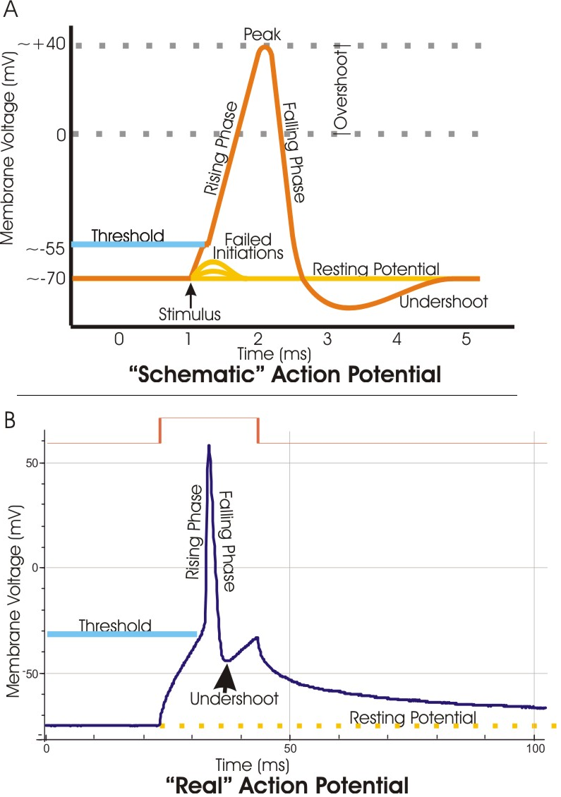
Action Potential
Animal | Cell type | Resting potential (mV) | AP increase (mV) | AP duration (ms) | Conduction speed (m/s)
Squid (Loligo) | Giant axon | −60 | 120 | 0.75 | 35
Earthworm (Lumbricus) | Median giant fiber | −70 | 100 | 1.0 | 30
Cockroach (Periplaneta) | Giant fiber | −70 | 80–104 | 0.4 | 10
Frog (Rana) | Sciatic nerve axon | −60 to −80 | 110–130 | 1.0 | 7–30
Cat (Felis) | Spinal motor neuron | −55 to −80 | 80–110 | 1–1.5 | 30–120
Notes:
http://en.wikipedia.org/wiki/Action_potential
http://upload.wikimedia.org/wikipedia/commons/c/cc/Action_potential_vert.png

Slide 4
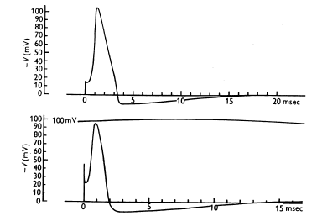
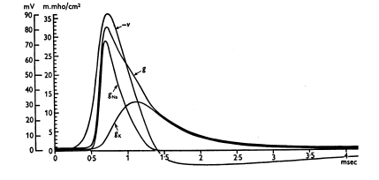
Results from the 50’s
Notes:
Why so late? The voltage clamp was only invented a little earlier, H&H first to successfully apply the clamp to membrane. These are figures from H&H’s seminal paper. Their models look good. The disparity in time scale could have something to do with temperature.
Mention the fact that the resting potential should be -70mV, explain the time course of conductances. ‘Permeability depends on voltage and time’
They think the voltage goes down, we think the voltage goes up.
They applied voltage and measured current, we have an equation where current is applied and voltage is measured

Slide 5
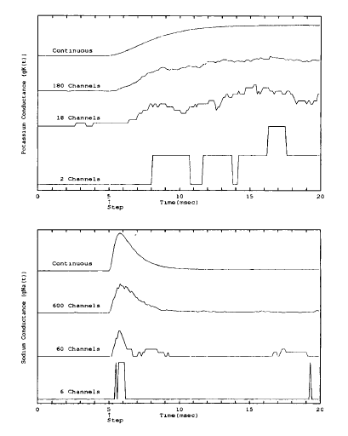
Sodium and Potassium
Notes:
Sodium reacts first, but the effect dies quickly. Potassium reacts slower, lasts longer. The ions flow in opposite directions, so current flows in, then out before balancing out

Slide 6

Governing Equations
$$\frac{dV_{m}(t)}{dt}= −\frac{1}{C_{m}}[\left(V_{m}\left(t\right)−E_{L}\right)g_{L}+\left(V_{m}\left(t\right)−E_{K}\right)g_{K}+(V_{m}\left(t\right)−E_{Na})g_{Na}−I_{app}\left(t\right)]$$
$$α_{n}=\frac{0.01\left(V_{m}+10\right)}{e^{\frac{V_{m}+10}{10}}−1} β_{n}=0.125e^{\frac{V_{m}}{80}}$$
$$α_{m}=\frac{0.1\left(V_{m}+25\right)}{e^{\frac{V_{m}+25}{10}}−1} β_{m}=4e^{\frac{V_{m}}{18}}$$
$${ α}_{h}=0.07e^{\frac{V_{m}}{20}} β_{h}=\frac{1}{e^{\frac{V_{m}+30}{30}}+1}$$
Notes:
CM, EL, GL, EK, EN constant, I, V variables. Set I solve for V, or the other way around.
GL, GK are calculated in different was for different methods

Slide 7



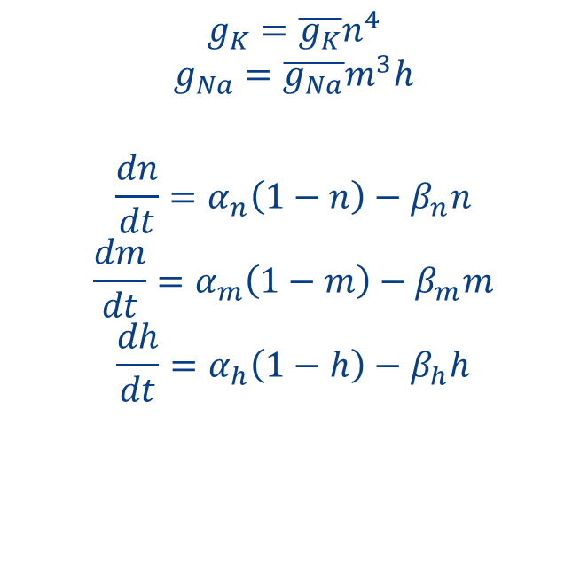
Equations continued
Differential Scheme
Markov Kinetic Scheme
$$g_{K}=\overline{g_{K}}n^{4}$$
$$g_{Na}=\overline{g_{Na}}m^{3}h$$
$$\frac{dn}{dt}=α_{n}\left(1−n\right)−β_{n}n$$
$$\frac{dm}{dt}=α_{m}\left(1−m\right)−β_{m}m$$
$$\frac{dh}{dt}=α_{h}\left(1−h\right)−β_{h}h$$
$$g_{Na}=γ_{Na}\left[m_{3}h_{1}\right]$$
$$g_{K}=γ_{K}[n_{4}]$$
Notes:
Explain

Slide 8
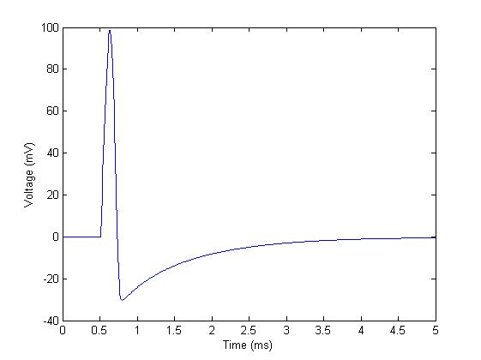
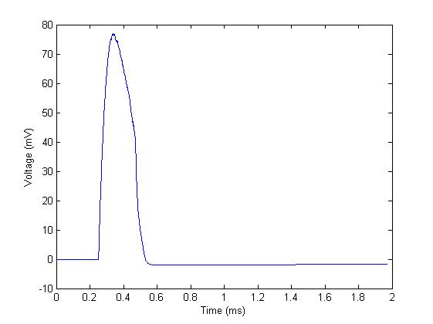
Results
Notes:
This is proof the model worked. Compare

Slide 9
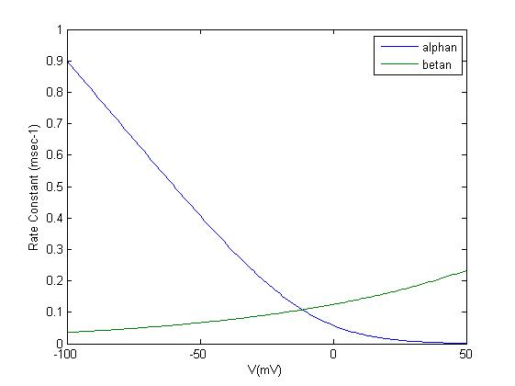
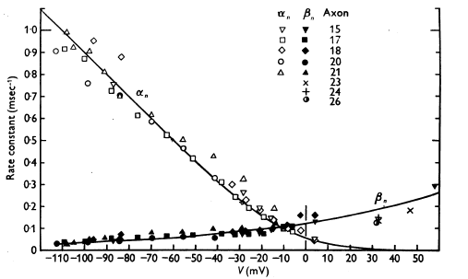
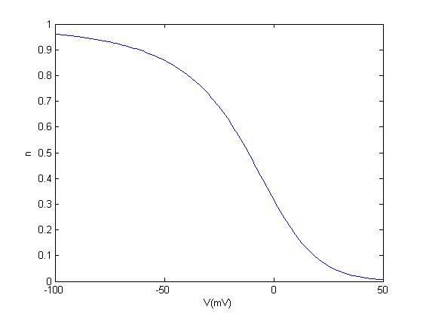
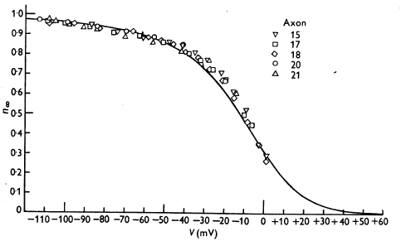
α_{n}, β_{n}, n
Notes:
These are rate constants that depend only on voltage. H&H invented them, and basically tried to fit data to equations. I plotted their equations, big deal, right. This is one of the first things I did right.

Slide 10
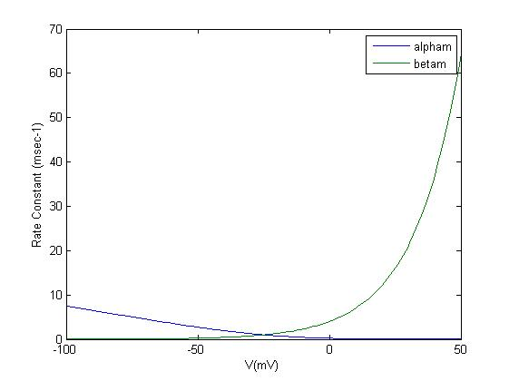
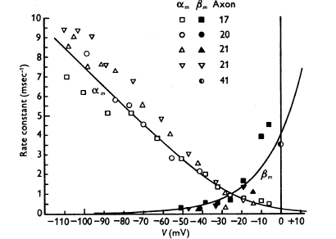
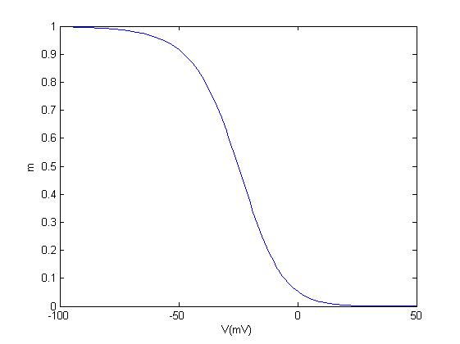
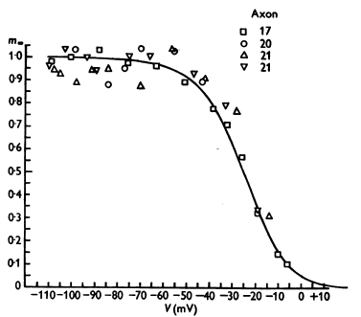
α_{m}, β_{m}, m

Slide 11
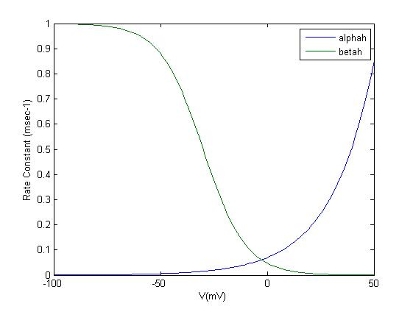
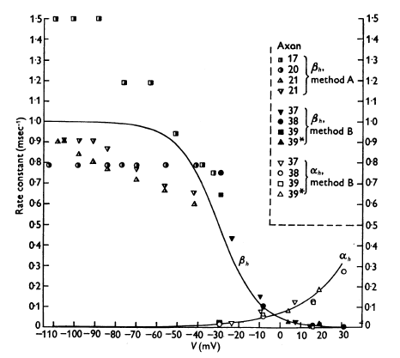
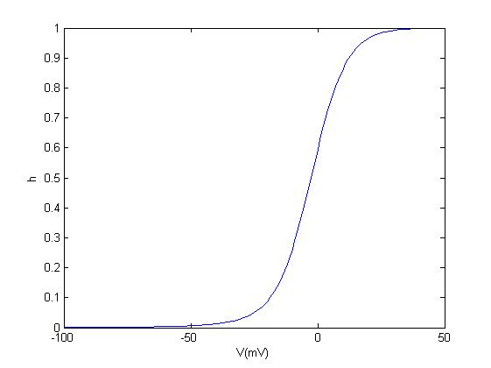
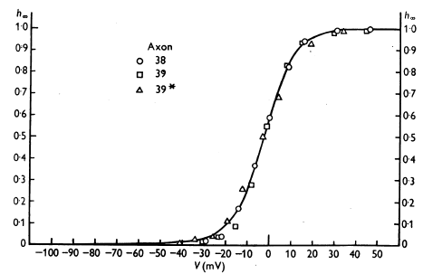
α_{h}, β_{h}, h

Slide 12
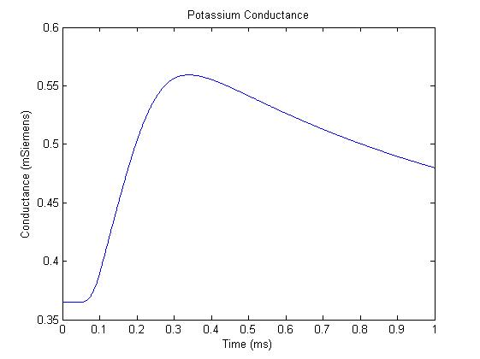
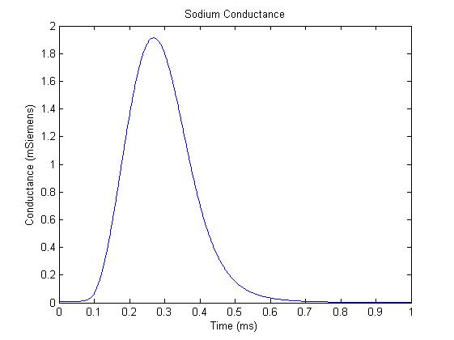
Conductance
Notes:
This was done by forcing the voltage to -50mV

Slide 13
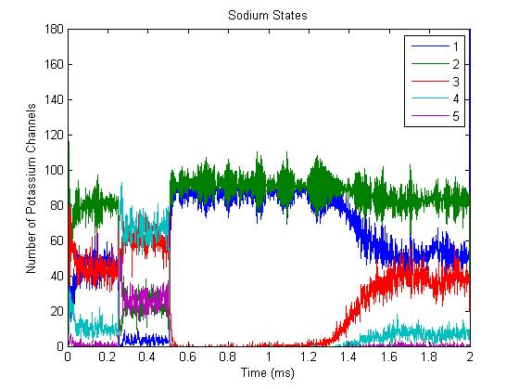
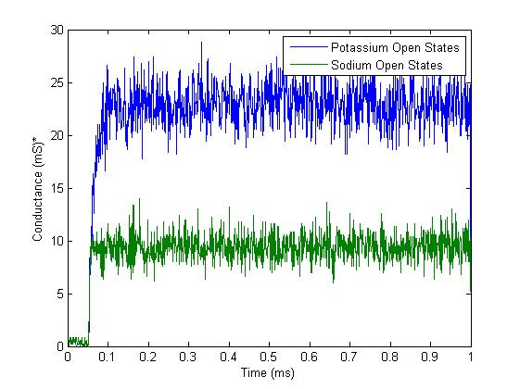
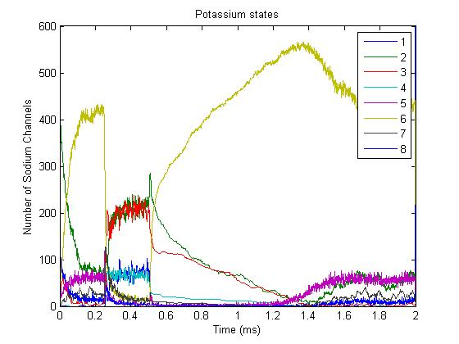
Stochastic

Slide 14
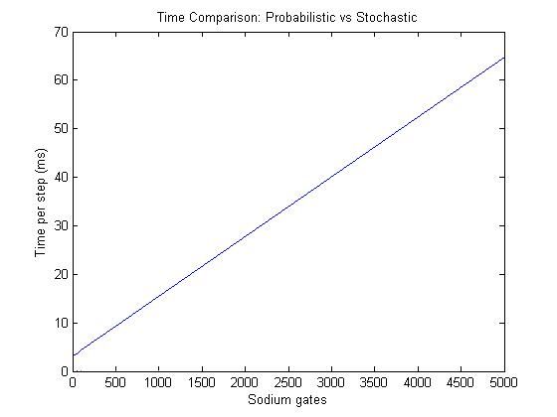
Time Claims
Notes:
This is one of two goals, 1) simulate this thing, 2) compare speeds. Mino et al said 36 times faster, I found at least 100 times faster.
What did they do? They abbreviated the computation, disregarded important parts of the equations. Also maybe they were smarter and that’s why they were faster.

Slide 15
Questions?

